Slide 1
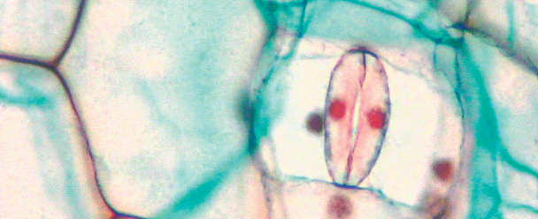
Cells: The Exchange of Materials

Slide 2
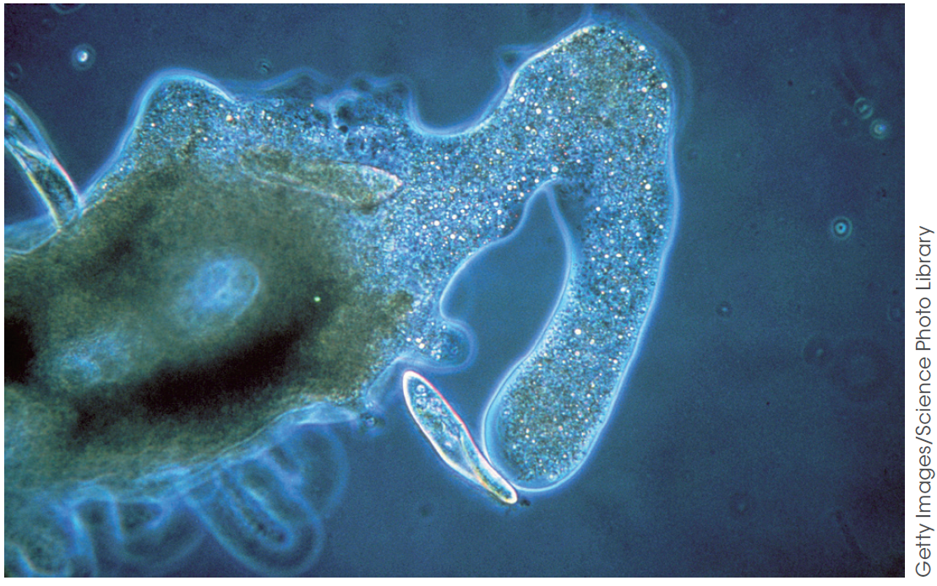
Cell plasma membrane
The plasma membrane: the boundary of cells
The plasma membrane forms the boundary between the internal environment of the cell, the cytoplasm and its external environment.
It is selectively permeable (that is, controls the movement of substances into and out of cells).
Figure 8.2
An Amoeba engulfing food demonstrates the flexibility of the plasma membrane.

Slide 3
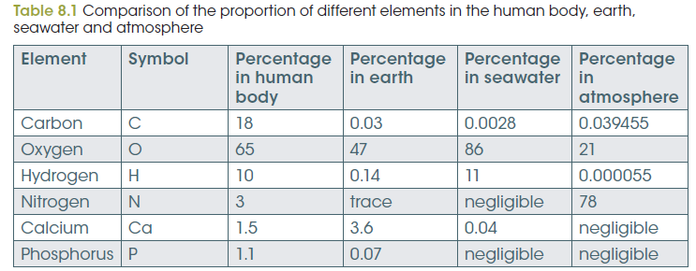
The internal and external environments
The plasma membrane: the boundary of cells
Notes:
Almost 99% of the mass of an average human body is made up of only six elements: oxygen, carbon, hydrogen, nitrogen, calcium and phosphorus. Table 8.1 shows that the proportions of these elements are very different in the human body compared with the external environment in the earth, sea and atmosphere.
The cells in multicellular organisms are more protected from the swings of environmental change because they are surrounded by extracellular fluid. In humans, the contents of this liquid are kept fairly constant by the workings of various organs such as the lungs, kidneys and liver. Nevertheless, the internal cellular environment has very different concentrations of some substances compared with the extracellular environment (Table 8.2).

Slide 4
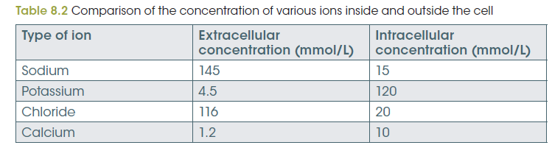
The internal and external environments
The plasma membrane: the boundary of cells
Notes:
Almost 99% of the mass of an average human body is made up of only six elements: oxygen, carbon, hydrogen, nitrogen, calcium and phosphorus. Table 8.1 shows that the proportions of these elements are very different in the human body compared with the external environment in the earth, sea and atmosphere.
The cells in multicellular organisms are more protected from the swings of environmental change because they are surrounded by extracellular fluid. In humans, the contents of this liquid are kept fairly constant by the workings of various organs such as the lungs, kidneys and liver. Nevertheless, the internal cellular environment has very different concentrations of some substances compared with the extracellular environment (Table 8.2).

Slide 5
The internal environment of cells is kept stable
The plasma membrane: the boundary of cells
Plasma membrane regulates the internal environment.
Complex chemical reaction including respiration and photosynthesis.
Enzymes can only perform their tasks within narrow temperature and pH ranges.
Hydrogen ion concentrations kept within strict limits to maintain suitable cytoplasmic pH.
Toxic waste products are removed to ensure they do not interfere with chemical reactions in the cytoplasm.
Notes:
Depending on its activities, a cell will need to take in certain useful molecules and ions from the external environment and excrete others. For example, a cell producing protein will need to take in a variety of amino acids. When substances like calcium ions are used as signals for cell communication, their levels inside cells will need to be controlled.
Many cellular reactions need specific conditions in order to occur efficiently and effectively. Cellular processes such as photosynthesis and respiration use enzymes to speed up chemical reactions to a point where each step proceeds smoothly to the next. Enzymes can only perform their tasks within narrow temperature and pH ranges. Hydrogen ion concentrations must be kept within strict limits to maintain suitable cytoplasmic pH levels. Toxic waste products need to be removed to ensure they do not interfere with chemical reactions in the cytoplasm. For all these reasons, the plasma membrane must regulate the internal environment of the cell.

Slide 6
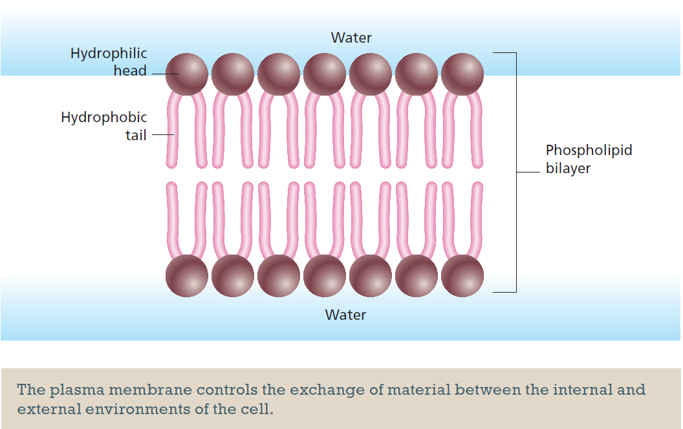
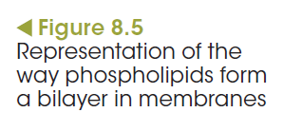
Structure of membranes: the fluid mosaic model
The plasma membrane: the boundary of cells
Notes:
A phosphate group on the head makes this end hydrophilic (able to absorb water or dissolve in water) and the fatty acid tails are hydrophobic (water avoiding or unable to dissolve in water). This means that while the heads
are attracted to water, the tails are repelled. When these molecules spontaneously form a bilayer, the fatty acid tails turn inwards, away from the watery environment and cytoplasm, and towards each other (Figure 8.5), rather like salad oil forming a film on the surface of water.
Cholesterol interferes with interactions between the lipid tails, making the membrane more flexible. In plants and bacteria, phytosterol not cholesterol increases membrane flexibility.
The lipid components of all membranes, whether from plants, animals or bacteria, provide membranes with the unique properties of being flexible and able to repair themselves. This allows cells to change shape and grow.

Slide 7
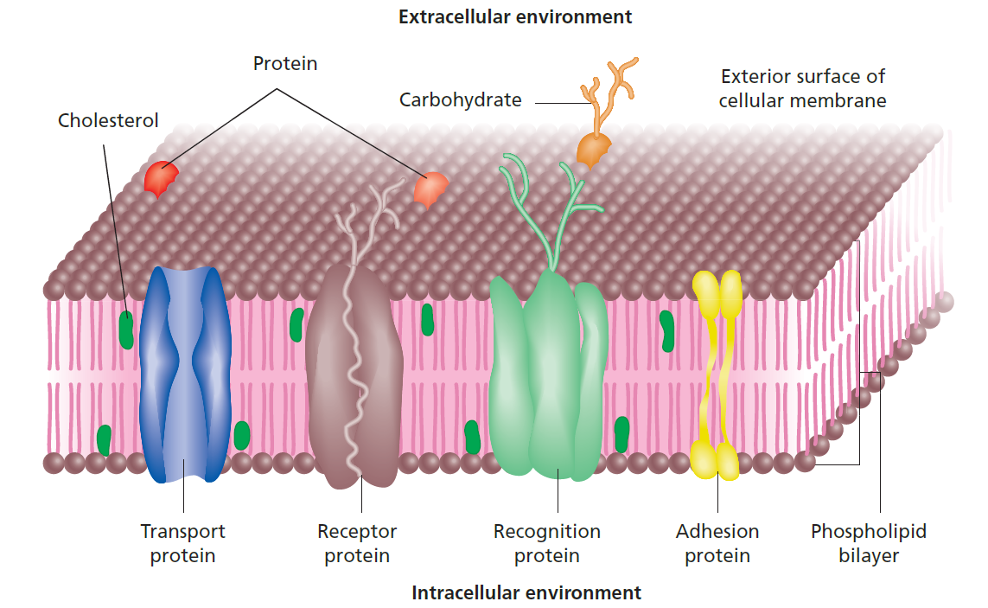
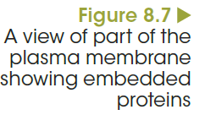
Structure of membranes: the fluid mosaic model
The plasma membrane: the boundary of cells
Notes:
Adhesion proteins link cells together to maintain both the three-dimensional structure and the normal functioning of tissues.
Transport proteins act as passageways that allow specific substances to move across the membrane. An example is the rapid movement of ions across the membrane when a nerve is stimulated.
Membrane proteins are also involved in cellular communication. Receptor proteins bind hormones and other substances that cause changes to the cell’s activities.
Membrane recognition proteins, which are called glycoproteins because they combine with a sugar molecule, are unique to each individual. They act as markers, called antigens, which allow the immune system to distinguish between the body’s own ‘self’ cells, and foreign invaders (‘non-self’ cells).

Slide 8
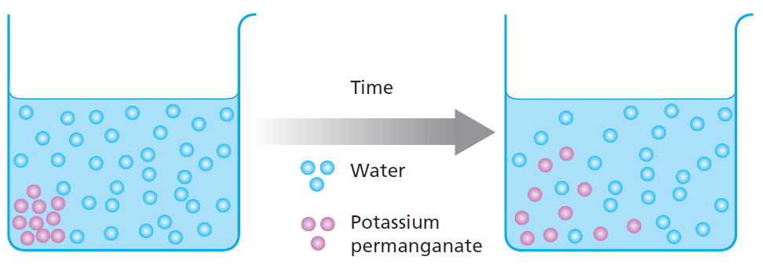
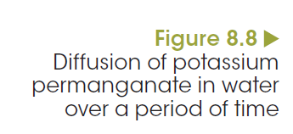
Diffusion
Passive movement across membranes

Slide 9
Diffusion
Passive movement across membranes
Movement of particles down a concentration gradient, from where they are in high concentration to where they are in low concentration, is passive and does not require energy.
Notes:
Materials can move across membranes either with or without the expenditure of energy.
Movement that does not require energy is called passive transport.
Diffusion is the net movement of particles from a region of high particle concentration to a region of lower particle concentration.
The difference in particle concentration between the two regions is called the concentration gradient. Diffusion always takes place wherever such a gradient exists and continues until the particles are distributed evenly throughout the system. When that happens, equilibrium is said to be reached. Particles will continue to move randomly, but at equilibrium they move at equal rates in all directions.

Slide 10
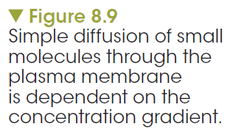
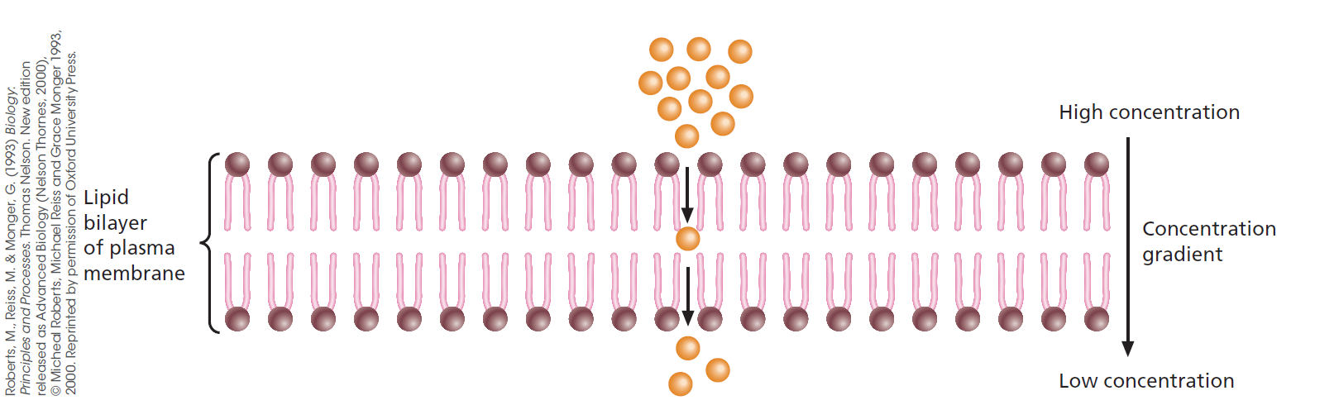
Diffusion
Passive movement across membranes
Diffusion across membranes
Notes:
Substances like oxygen, water, carbon dioxide and other small, uncharged particles move easily through the plasma membrane of a cell by simple diffusion. Figure 8.9 shows these particles passing between the phospholipid molecules from a high to a low concentration. Oxygen always tends to diffuse into cells because their use of oxygen in cellular respiration maintains a low concentration in the cytoplasm.

Slide 11
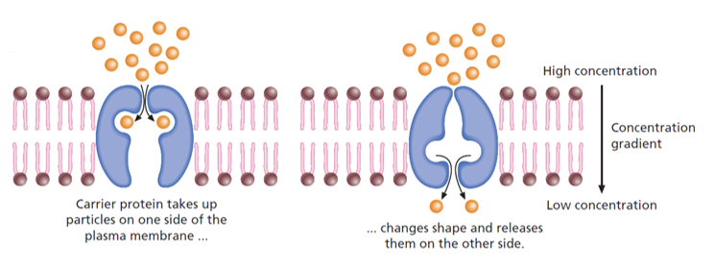
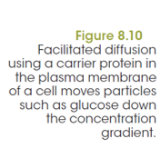
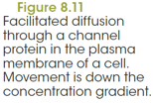
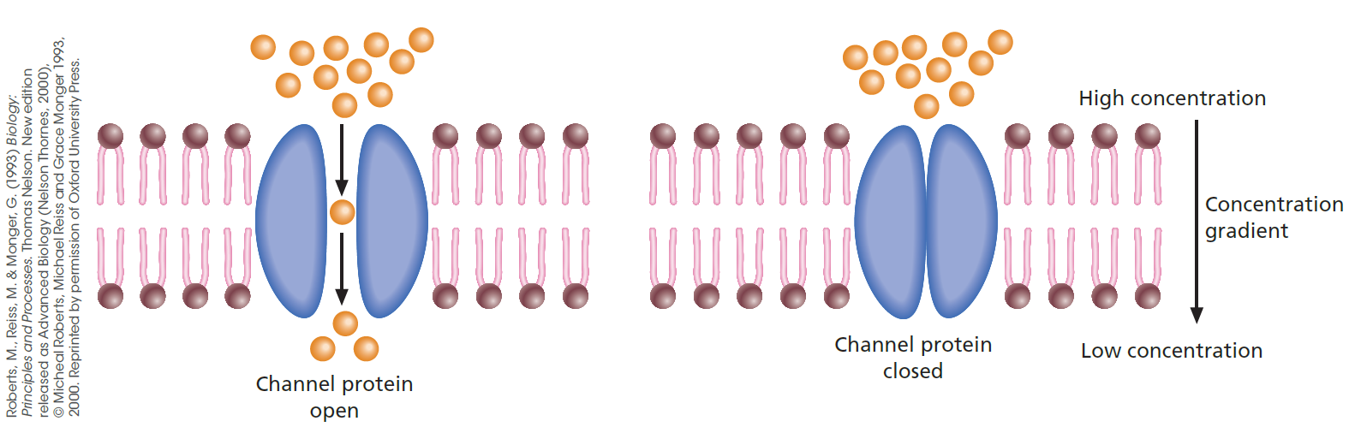
Diffusion
Passive movement across membranes
Facilitated diffusion
Notes:
Charged particles, such as sodium and chloride ions, and relatively large molecules, such as glucose and amino acids, do not pass through the phospholipid bilayer readily. There must be some way to help them enter the cell. In the plasma membrane, certain proteins assist such particles to diffuse into the cell. This process is called facilitated diffusion.
Two types of protein are involved in facilitated diffusion: carrier proteins and channel proteins. Carrier proteins bind to specific molecules on one side of the membrane, change shape and release the substance on the other side (Figure 8.10). An example is the glucose transporter protein, which is located in the plasma membrane of all mammalian cell types and carries glucose in either direction, depending on the direction of the concentration gradient.
Channel proteins form narrow passageways through which small ions can diffuse rapidly from a high ion concentration to a lower ion concentration (Figure 8.11). Only ions of a specific size and shape can pass through a particular channel protein.

Slide 12
Osmosis
Passive movement across membranes
Movement of water, across a semi-permeable membrane, down a concentration gradient, from where water is in high concentration to where it is in low concentration. It is passive and does not require energy.

Slide 13
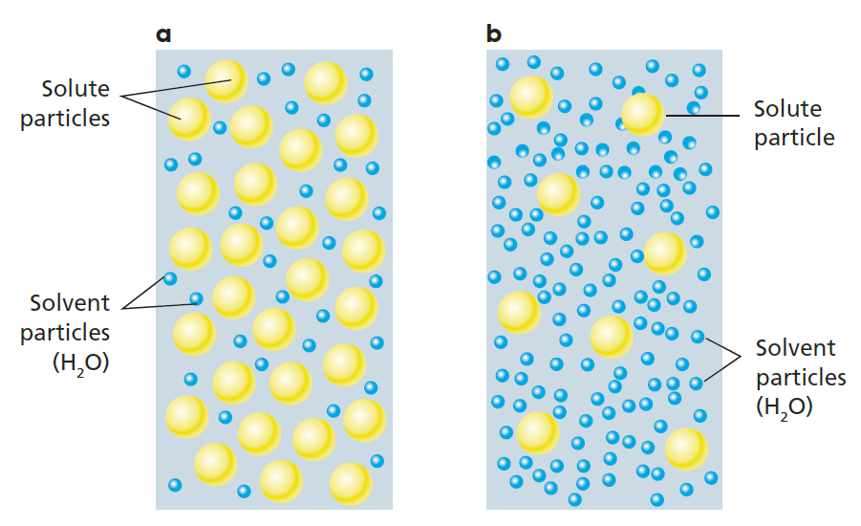
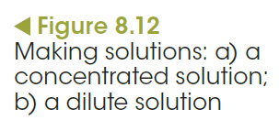
Osmosis: a special type of diffusion
Passive movement across membranes
Solution (mixture of particles) = solvent particles + solute particles
High-concentration solution = low concentration of solvent + high concentration of solute
Low-concentration solution = high concentration of solvent + low concentration of solute
Notes:
Water is the medium in which biochemical processes take place, water transports materials in solution, it helps keep cells in shape and it forms the fluid that bathes tissues. Water is described as the universal solvent. If you add sugar or salt to water, you are adding solute to solvent and making a solution. A dilute solution has a relatively high concentration of water molecules compared to solute particles dissolved in it, whereas a concentrated solution has a low concentration of solvent molecules and a high concentration of solute particles (Figure 8.12).

Slide 14
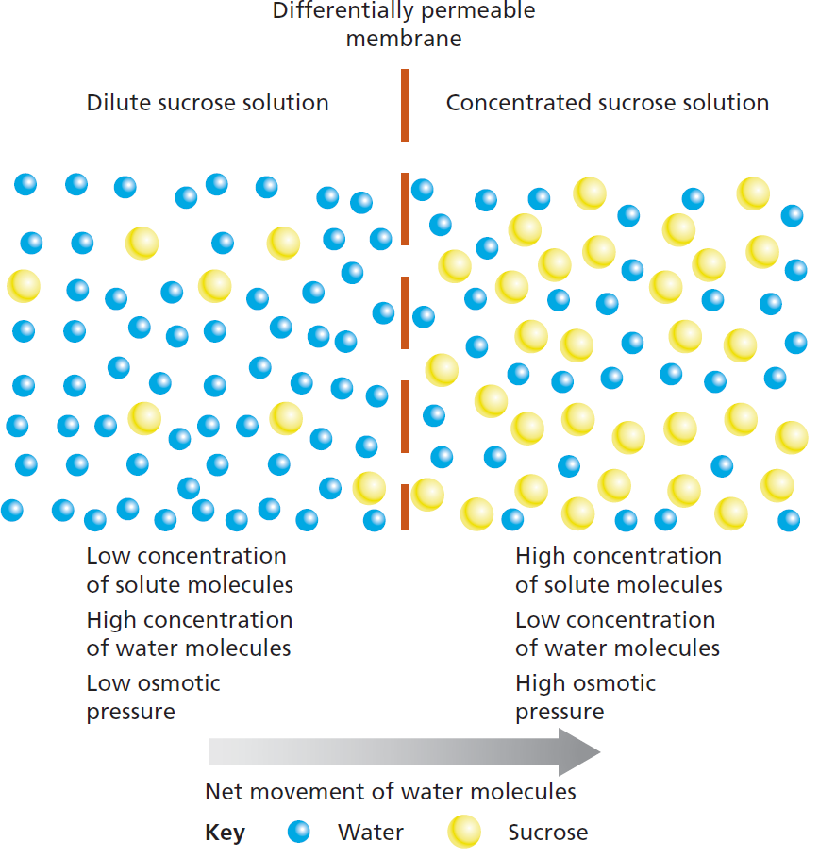
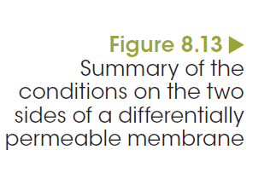
Osmosis: a special type of diffusion
Passive movement across membranes
Notes:
Plasma membranes are selectively (differentially) permeable, meaning that water molecules pass through them easily, but solutes do not. If the concentration of water molecules inside a cell is lower than the concentration outside, water will diffuse into the cell, until a balance or equilibrium is reached. This process is called osmosis. By definition, osmosis is the diffusion of water across a selectively permeable membrane from an area of high water concentration (low solute) to an area of low water concentration (high solute). Osmosis is a special type of diffusion and, like diffusion, requires no input of energy, as water is moving down its concentration gradient (Figure 8.13).

Slide 15
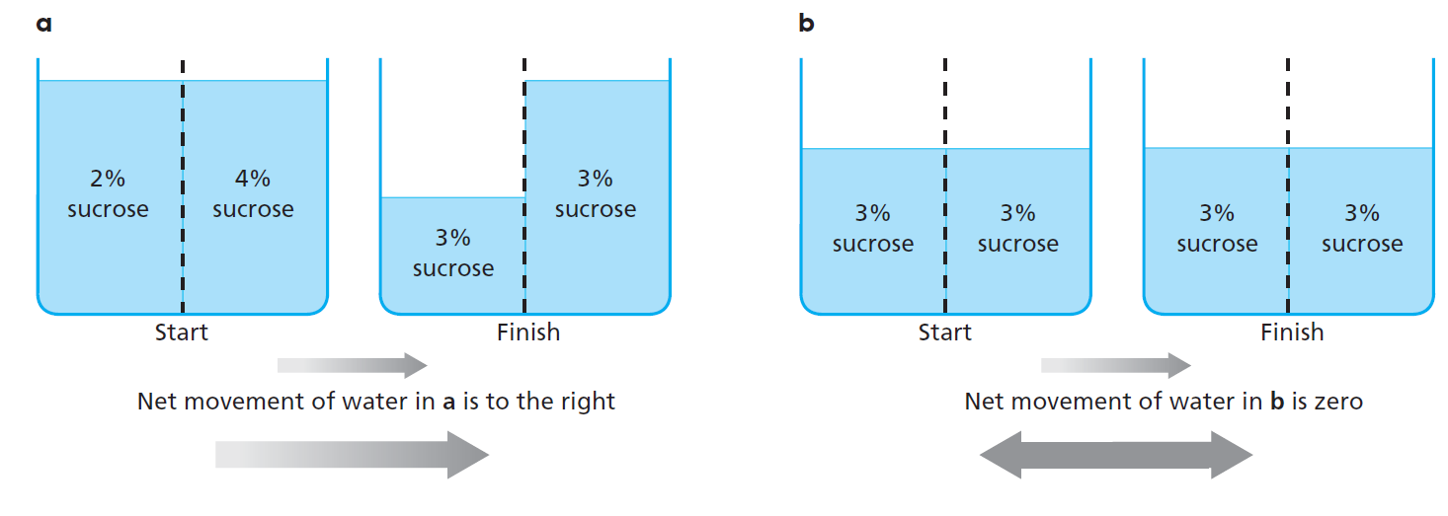
Osmosis: a special type of diffusion
Passive movement across membranes
Notes:
If the fluids inside and outside a cell are of equal solute concentration, the external solution is said to be isotonic (‘iso’ = same) to the cells; water molecules jostle on both sides of the membrane, moving in both directions equally.
When cells are surrounded by a solution that contains a lower solute concentration than their cytoplasm, the external solution is said to be hypotonic to the cells (‘hypo’ 5 lower). Water molecules will diffuse through the membrane into the cells. The reverse applies if the cells are surrounded by a solution of higher solute concentration; the external solution is hypertonic (‘hyper’ 5 higher) to the cells and water molecules will diffuse out.

Slide 16
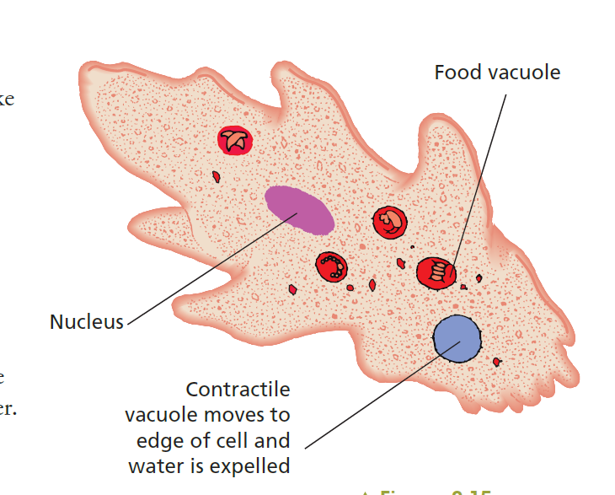
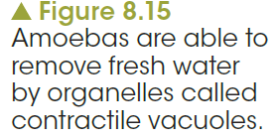
Osmosis: a special type of diffusion
Passive movement across membranes
Osmosis in animals
Notes:
The cells of unicellular eukaryotes and multicellular organisms, such as animals, are surrounded only by a plasma membrane, unlike the cells of plants, fungi and bacteria, where a cell wall surrounds the plasma membrane. Hypertonic solutions, like fresh water, pose a special problem for these organisms. Water moving into their cells by osmosis can cause the fluid plasma membrane to swell and eventually burst, killing the organism. Unicellular organisms such as Amoeba that live in fresh water have important regulatory mechanisms to combat these problems. They are able to remove excess water by forming little pools of water in cytoplasmic organelles called contractile vacuoles (Figure 8.15). When these vacuoles stretch to a certain point, they contract and expel the water.

Slide 17
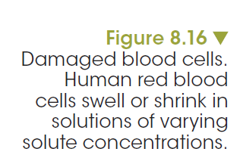
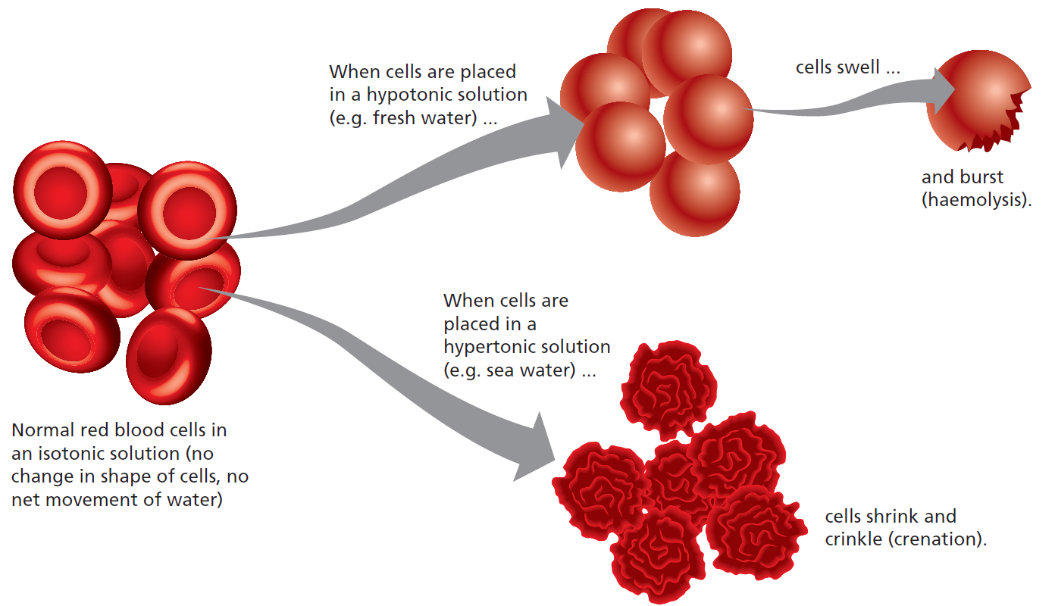
Osmosis: a special type of diffusion
Passive movement across membranes
Osmosis in animals
Notes:
You may have been in hospital and seen patients hooked up to an intravenous drip. This drip is connected directly to their circulatory system, adding fluid to their blood plasma. It is important that fluid in the drip has a solute concentration equal to blood plasma (isotonic). In this situation, water will enter and leave blood cells at the same rate, maintaining their ideal water concentration.
What will happen if the intravenous drip contains salty water? If the plasma surrounding blood cells becomes hypertonic, water will move out of the cells by osmosis and, in a process called crenation, they will shrink and become crinkled (Figure 8.16). The resulting small, shrunken blood cells tend to stick together, clogging small veins and arteries, and preventing oxygen reaching body tissues. If enough blockages occur, the results may be fatal. It is equally dangerous for an intravenous solution to be hypotonic. If the blood plasma is diluted by water, the blood cells will swell and burst. This condition is called haemolysis and it can seriously reduce the amount of oxygen being transported to body tissues. Because of these effects of osmosis on animal cells, it is important that the solute concentration of blood plasma is regulated by the kidneys.

Slide 18
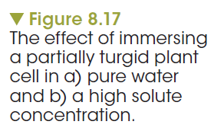
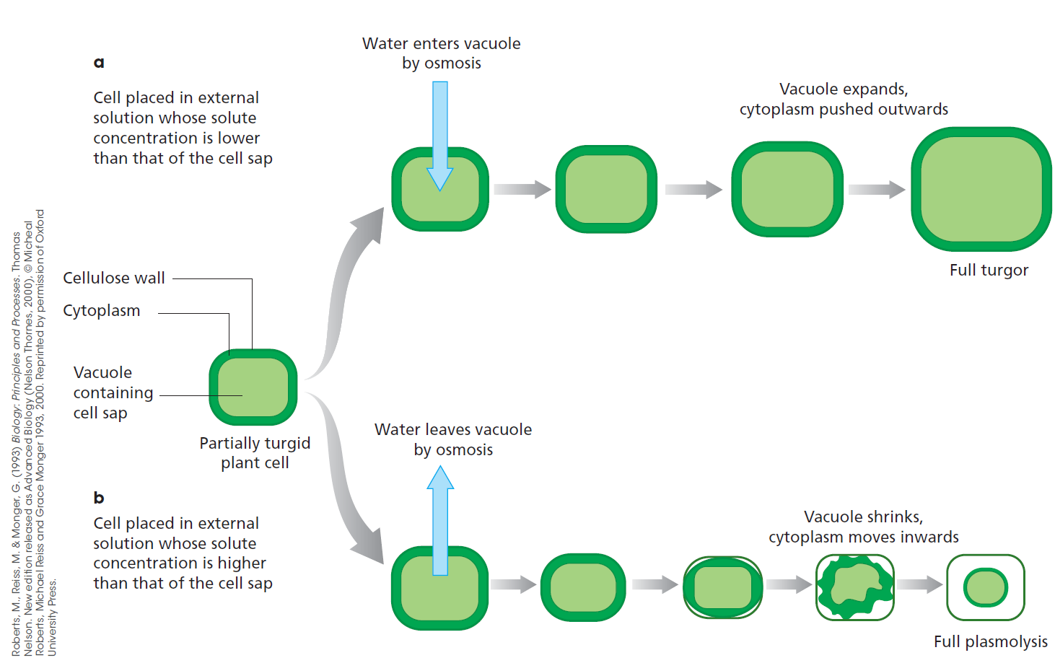
Osmosis: a special type of diffusion
Passive movement across membranes
Osmosis in plants

Slide 19
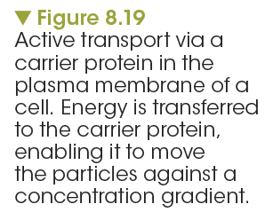

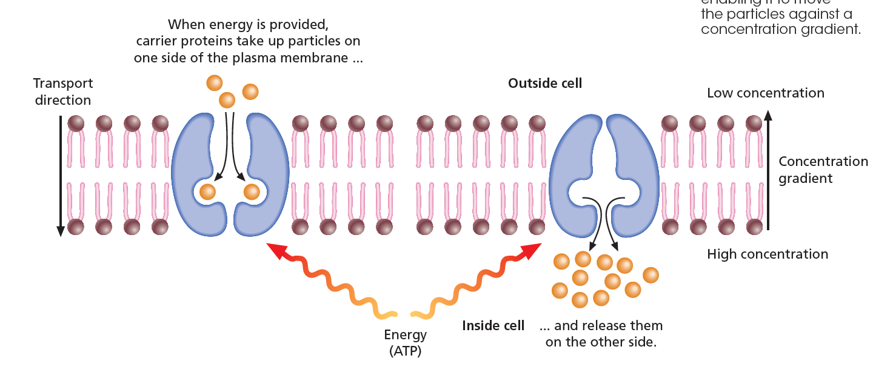
Active transport
Movement across membranes using energy
Active transport requires energy because it is the movement of nutrients from areas of low to areas of high concentration.
Notes:
How does active transport take place? Membrane transport proteins, similar to those responsible for facilitated diffusion, use energy from adenosine triphosphate (ATP) to move molecules or ions up their concentration gradient (Figure 8.19). As these carrier proteins work in only one direction, they effectively act as one-way valves.

Slide 20
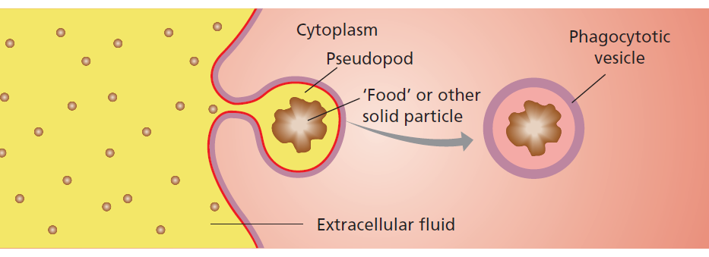
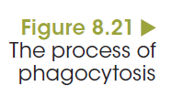
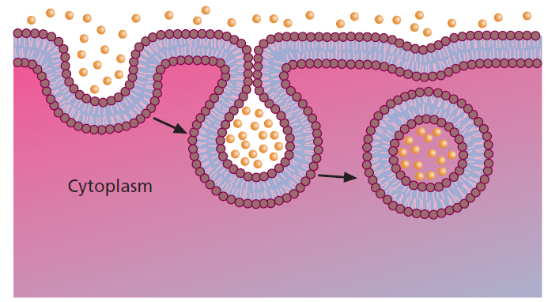

Endocytosis
Movement across membranes using energy
Notes:
The two types of endocytosis discussed in this chapter are named according to the type of material consumed. The process that engulfs solids, like an amoeba eating, is called phagocytosis and the other process that takes in droplets of liquid is pinocytosis.

Slide 21
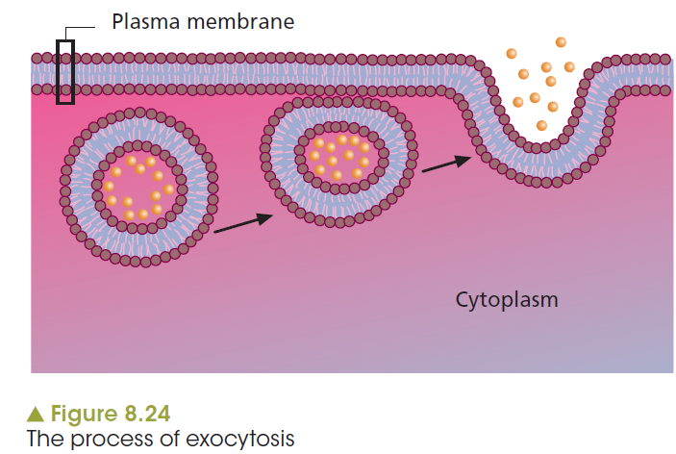
Exocytosis
Movement across membranes using energy
Notes:
Specialised animal cells produce a variety of substances, such as hormones, mucus, milk proteins and digestive enzymes, which have important functions elsewhere in the organism. This is also true for plants, where particular cells are specialised to produce products that need to be relocated. These include growth regulators, toxins to ward off predators and macromolecules for use elsewhere. In all these cases, exocytosis is involved.

Slide 22
Chemical factors
Factors affecting the exchange of materials
Indicate how substance will behave in the extracellular environment.
Affect their transport across cell membranes.
Ethanol and chloroform are able penetrate and cross membranes because they are uncharged molecules.
Dissolve in the phospholipid bilayer.
Charged ions sodium (Na⁺), potassium (K⁺) and calcium (Ca²⁺) which are hydrophilic, cannot cross the hydrophobic interior of the membrane.
Charged ions move through specific ion channels.

Slide 23
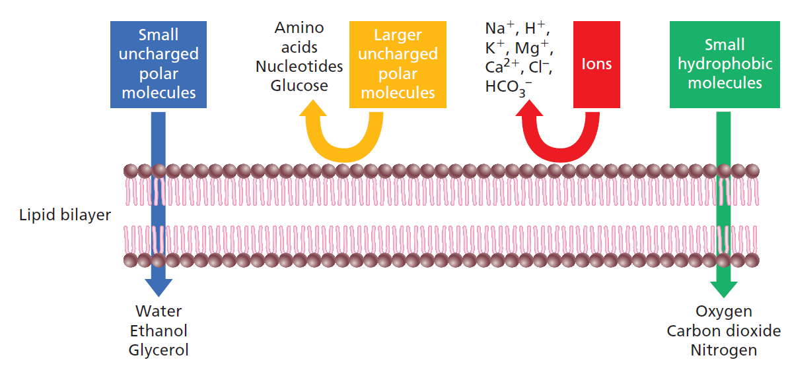
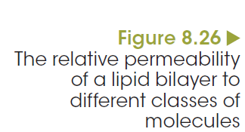
Physical factors
Factors affecting the exchange of materials
Notes:
The physical properties of size and shape affect whether or not a substance moves across the plasma membrane, how it is transported and how quickly it moves. Small molecules like water, oxygen and carbon dioxide are able to slip between the phospholipids. They cross the membrane easily and quickly, diffusing passively from a high concentration to a low concentration.

Slide 24
Concentration gradients
Factors affecting the exchange of materials
As the concentrations across membranes become similar, the rate of diffusion slows.
To maintain a rapid rate of diffusion.
Plant cells:
  Carry out cytoplasmic streaming whereby organelles and cytosol flow through the cell in a circular movement.
Multicellular animals:
  Circulatory system remove the diffused substance, away from the cells.
  Convert the diffused substance into something else.
Notes:
For example, when glucose molecules diffuse into liver cells, some are used up and others converted to glycogen, maintaining a steep concentration gradient.

Slide 25
Size and shape of cells
Factors affecting the exchange of materials
Surface-area-to-volume ratio
Needs a large surface area in relation to its volume. Large surface-area-to-volume ratio.
As cells grow larger, both its surface area and volume increase. Volume grows faster than surface area.
As size of a cell increases the surface-area-to-volume ratio decreases.
Efficiency of material transport decreases.
Cells tend to be very small
Notes:
An important concept related to exchange across membranes is the surface-area-to-volume (SA:volume) ratio. This ratio may be expressed as a single number, for example 3, or a ratio, for example 3:1. It represents an important relationship between the area of the membrane surrounding a cell and the volume of its cytoplasm.
Surface area is the area of membrane around the cell and the volume is the amount of cytoplasm.

Slide 26
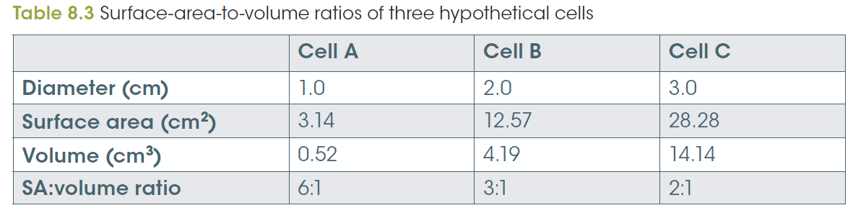
Size and shape of cells
Factors affecting the exchange of materials
Notes:
Surface area is the area of membrane around the cell and the volume is the amount of cytoplasm. This is shown in Table 8.3. Cell A has a volume of 0.52 cm³ and a surface area of 3.14 cm² to service it. This is a surface-area-to-volume ratio of 6:1. Cell C, however, has a volume of 14.14 cm³ and a surface area of 28.28 cm² to service it, a surface-area-to-volume ratio of only 2:1.

Slide 27
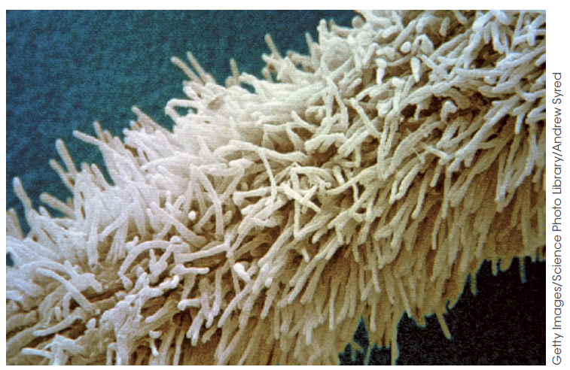
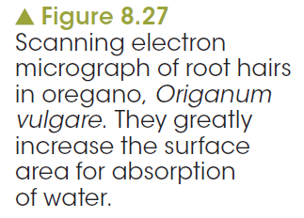
Some cells need to be large
Factors affecting the exchange of materials
Some cells like marjoram, muscle and nerve cells are very large.
How do they cope?
Depends on function.
Shape affects SA:V ratio.
Very thin, cylindrical axon can be up to a metre long.
Marjoram extends root hairs to increase SA:V ratio.

